Slide 1
Product Thinking & Hypermedia APIs

Slide 2

“So on the ocean of life, we pass and speak one another, only a look and a voice, then darkness again and a silence.” – Henry Wadsworth Longfellow
Hypermedia APIs
Developer Experience
(Productized APIs)

Slide 3

AFFORDANCE – “the qualities or properties of an object that define its possible uses or make clear how it can or should be used”
(http://www.merriam-webster.com/dictionary/affordance)

Slide 4
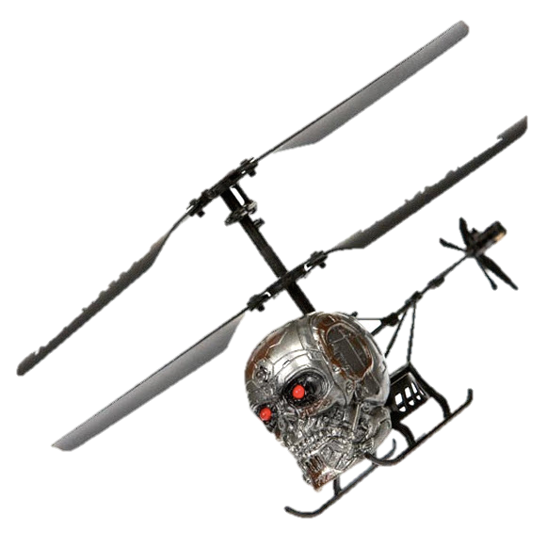
for our New Machine Overlords
AFFORDANCE – “the qualities or properties of an object that define its possible uses or make clear to a pre-programmed client how it can or should be used”

Slide 5

“Banking APIs *should* be hypermedia based”
2013

Slide 6
“Code to the interface – not the implementation”
2014

Slide 7
“Make it easy to do the right thing” (better tools less governance)
2015

Slide 8
“Organize yourselves around capabilities and treat those capabilities like products”
2016

Slide 9
“Banking APIs *can* be hypermedia based”
2017+

